Slide 1
"Hop on the Bus!"
Helping future teachers get on – and stay on - the college pathway

Slide 2
CWU Teacher Academies Support Team
Dawn Harry, Director Teacher Academies, Student Teaching, and Field Experience
Dr. Jenny Dechaine, School of Education Director, and Associate Dean of the College of Education and Professional Studies
Dr. Eric Hougan, Dr. Keith Reyes, Dr. Maria Hays, Dr. Bruce Palmquist, Jodi Musser, Hilary Hamlett, and Molly Lawson, CWU Faculty Liaisons
Amy Meyers and August Tibbits, Program Support Staff
Cami Bello, Tatiana Fox, and Douglas Jensen, School of Education Academic Advisors
Abner Ramos-Navarro, Lauren Nelson, Kimberly Ramos-Navarro, Linzay Jaime, and Vinessa Hubbard, CWU Teacher Academies Student Ambassadors
Notes:
Dawn

Slide 3
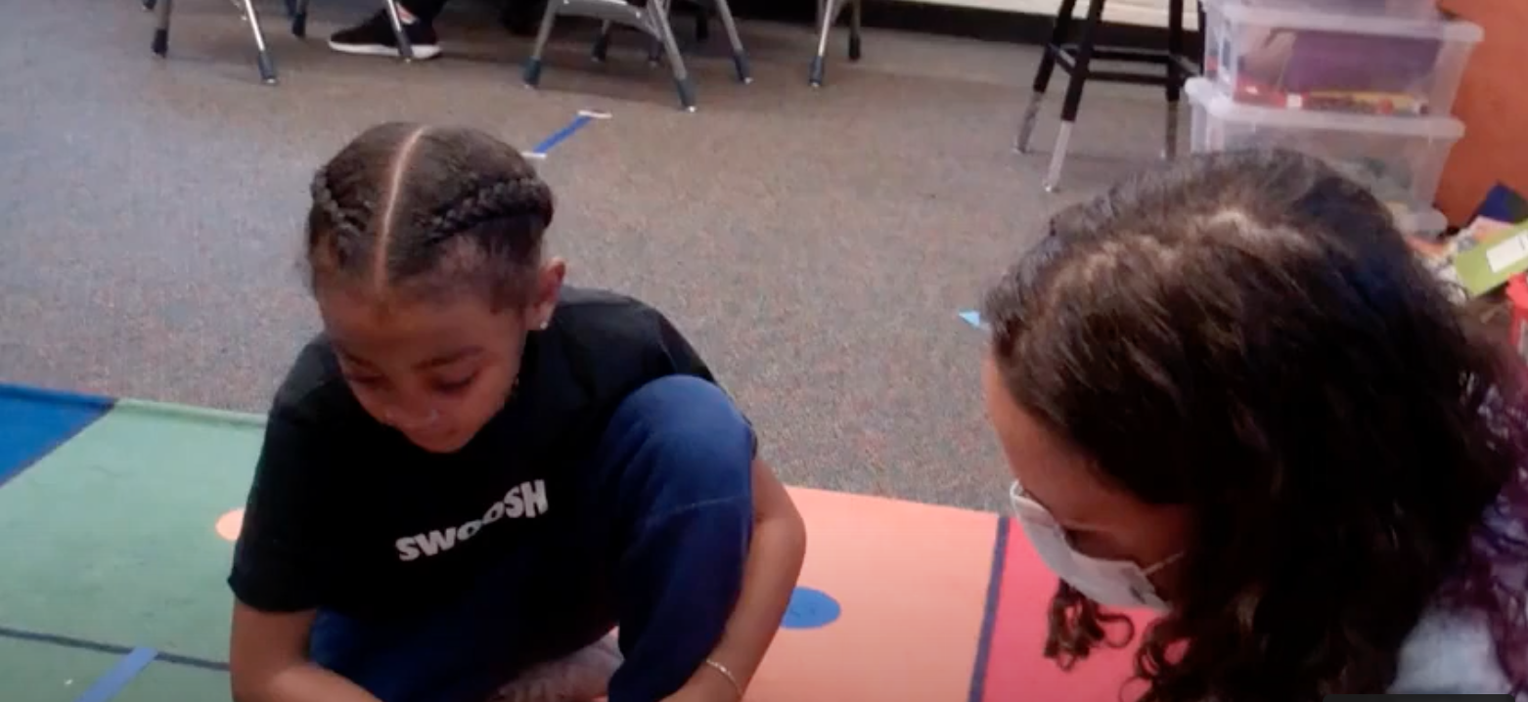
What is Teacher Academy?
https://www.youtube.com/watch?v=tVC7-l9dD_E
Notes:
Dawn – link: https://www.youtube.com/watch?v=lKUpLyRkCg0

Slide 4
CWU Teacher Academies Support Model
Who Do We Support?
Aims/Goals
High school students considering a career in education
Transfer students who wish to become teachers
Current CWU students pursuing teacher certification.
Easing the teacher shortage, particularly in underserved areas
Diversifying the teaching profession by providing critical support to students on their teacher education pathways.
Notes:
Dawn

Slide 5
CWU Teacher Academies Support Model
Campus Connections
Advisor
Connections
Faculty Connections
Student
Connections
Notes:
Dawn

Slide 6
Campus Connections
Supports Teacher Academies studies through:
Welcoming high school Teacher Academies to our campuses including our regional Centers
Sometimes including overnight campus stays!
Classroom visits to our education classes in which TA students can interact with CWU faculty and students
Student panels with our CWU Teacher Academy alumni to share their experiences in teacher education at CWU
Collaboration conversations between high school Teacher Academies teachers and school leaders and CWU TA staff on how we can best support their district’s teacher pipeline
Notes:
Cami

Slide 7
Puyallup goes to CWU!
TIME | LOCATION | ACTIVITY
9:00/9:15 | Back entrance of Black Hall on Chestnut Street | Arrival at CWU
9:15-10:30 | Black Hall Classrooms: | Class Observations:
 | Black Hall 122 | Elem 323 w/Katie Lawless
 | Black Hall 201 | ELEM 321 w/Sharryn Walker
 | Black Hall 223 | ELEM 342 w/Amanda Obery
10:30-11:30 | Wildcat Statue on the East SURC patio | Campus Tour
11:30-12:00 | Black Hall 150 | Education Programs Presentation with Taylor
12:00-12:30 | Black Hall 150 | Teacher Academies Student Panel with Ingrid and Lauren
12:30-1:30 | SURC | Lunch!
Notes:
Cami

Slide 8
ADVISING CONNECTIONS
Supports High School Teacher Academies for our College in the High School partner schools through:
A CWU School of Education Academic Advisor assigned to support the high school Teacher Academy class in
Planning individualized campus visits
Answering questions about teacher education opportunities
Connecting students with financial aid resources
Providing information on teacher education pathways including transferring credits from College in the High School and our 2-year college partners
Opportunities for classroom visits by the Academic Advisor
Partnering with the 2-year college advisors to co-advise students who want to transfer to CWU
Notes:
Cami

Slide 9
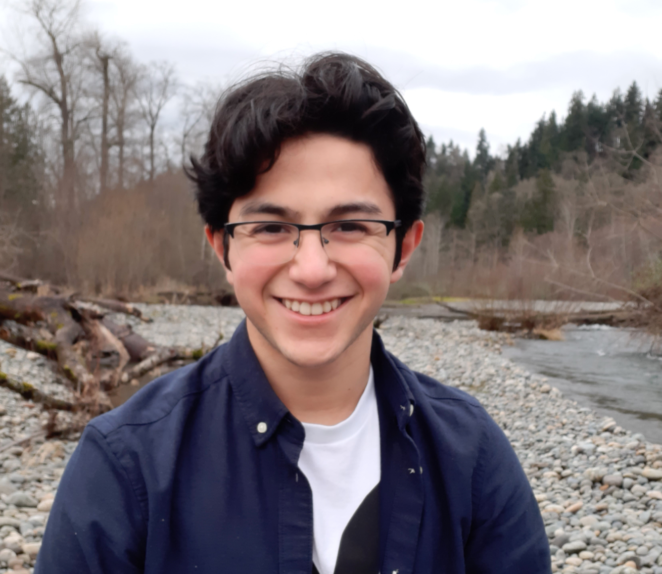
Advisor Cami and Student Ambassador Abner go to Othello!
Notes:
Cami

Slide 10
FACULTY CONNECTIONS
Each school that partners their Teacher Academy with CWU College in the High School EFC 250 Intro to Education credit has a faculty liaison assigned to them for support
Teacher Academies partner teachers receive a stipend for quarterly professional development to share ideas and get support on topics such as diversity training, recruitment strategies, curriculum ideas, etc.
We also have limited capacity to provide direct faculty support to a few High School Teacher Academies which includes:
Monthly visits to the TA class by the CWU faculty
Monthly collaboration meetings between the Teacher Academy high school coordinator and the CWU faculty member
Co-teaching by the CWU faculty and the high school teacher academy coordinator for the high school students and the college students so the TA students can get a feel for what it would be like to be a college student
TA high school students making connections with the faculty member and their current CWU education students
Notes:
Amy

Slide 11
Example: Co-Teaching for Renton TA plus CWU Ed Tech at CWU-Des Moines
Dr. Eric Hougan (CWU professor) and Teacher Academy Teacher Derrick Holt (Lindbergh High School) co-taught "Impactful Ed-Tech Tools for Online Learning"
CWU School of Education students at CWU Des Moines and High School Teacher Academy students in Renton collaborated to create a toolkit of resources for future teachers
This Photo by Unknown author is licensed under CC BY-SA-NC.
Notes:
Dawn & Lauren

Slide 12
STUDENT CONNECTIONS
Supports high school Teacher Academies, Current CWU Students and Transfer Students through:
Opportunities for TA high school students to make connections with current CWU education students during campus visits and during co-taught classes with CWU faculty
CWU Teacher Academy Alumni Student Ambassadors work alongside the Academic Advisors to provide information and support to each high school Teacher Academy class
Student Ambassadors plan events for Teacher Academy Graduates at CWU for professional development, support, and connection
Educators Rising club to support equity and diversity in education for teaching candidates
Educators Rising Annual Conference where our Student Ambassadors support the high school competitors from our partner schools in their competition events such as lesson planning, job search, children's literature, public speaking, etc.
Notes:
Lauren

Slide 13
CWU Student Ambassador Lauren Nelson
Questions are asked of our students that might be particularly relevant for first generation students, many of whom are from more collectivist cultures:
Do you miss your Family?
Is it hard to be away from home?
Is the food actually good?
What are classes like?
Student Ambassadors have gone through the Teacher Academies curriculum with its emphasis on equity and social justice, and are particularly well suited to support students who might be first generation college students, or who are underrepresented in the teaching profession
Notes:
Lauren

Slide 14
Takeaways from today's "stops"

Slide 15
How might the Teacher Academies Support Program benefit students?
What ideas do you have for how we might adjust this model to better serve your students?
Campus Connections
Advisor
Connections
Faculty Connections
Student
Connections

Slide 16
Thank you!

