Slide 1
Cryptography
The Making and Breaking of Secret Ciphers

Slide 2
The next competition is scheduled for
April 18 – 22, 2013
http://www.cwu.edu/~boersmas/kryptos

Slide 3
A Tour of the first set of challenges
Challenge 1 (solution)
Challenge 2 (solution)
Challenge 3 (solution)

Slide 4
A tour of the second set
Challenge 1 (solution)
Challenge 2 (solution)
Challenge 3 (solution)

Slide 5
A survey of common methods: Transposition Ciphers
In a transposition cipher the letters in the plaintext are just transposed or “mixed up”
The letter frequencies would reflect that of the usual language

Slide 6
Which ciphertext was encrypted using a transposition cipher?
thamatiemanicialisabanndmdainaoorkrokmlofoinglarabatckcchwhittisnedherinarw
TFTMAXFTMBVBTGBLTUEBGWFTGBGTWTKDKHHFEHHDBGZYHKTUETVDVTMPABVABLGMMAXKXWTKPBG

Slide 7
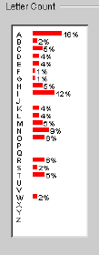
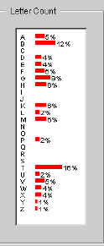
Frequency analysis

Slide 8
Decrypt – Problem 1
Thama tiema nicia lisab anndm daina oorkr okmlo foing larab atckc chwhi ttisn edher inarw

Slide 9
DEcrypt
Thama tiema nicia lisab anndm
AMATH EMATI CIANI SABLI NDMAN
daina oorkr okmlo foing larab
INADA RKROO MLOOK INGFO RABLA
atckc chwhi ttisn edher inarw
CKCAT WHICH ISNTT HERED ARWIN
A MATHEMATICIAN IS A BLIND MAN IN A DARK ROOM LOOKING FOR A BLACK CAT WHICH ISN’T THERE
----DARWIN
1 2 3
4 5

Slide 10
COLUMNAR transposition
Write the plaintext across the rows read the ciphertext down the columns
Encrypt using 4 columns (problem 2):
Spring has sprung
1 | 2 | 3 | 4
S | P | R | I
N | G | H | A
S | S | P | R
U | N | G
X
CIPHERTEXT: SNSUPGSNRHPGIAR
CIPHERTEXT: SNSUPGSNRHPGIARX

Slide 11
COLUMNAR transposition
We can also permute the columns before we write down the plaintext:
C | O | D | E
S | P | R | I
N | G | H | A
S | S | P | R
U | N | G
C | D | E | O
S | R | I | P
N | H | A | G
S | P | R | S
U | G |  | N
CIPHERTEXT: SNSUPGSNRHPGIAR
CIPHERTEXT: SNSURHPGIARPGSN

Slide 12
COLUMNAR transposition
2012 Cipher challenge 2
I | R | A | D | F | E
R | M | W | S | A | E
E | E | T | X | A | P
E | X

Slide 13
COLUMNAR transposition
2012 Cipher challenge 2
I | R | A | D | F | E
R | M | W | S | A | E
E | E | T | X | A | P
E | X
A
P
E
X
X

Slide 14
COLUMNAR transposition
2012 Cipher challenge 2
 | I | F | W | E | A
 | R | E | S | E | P
 | A | R | A | T | E
 | D | M | E | X | X
I | R | A | D | F | E
R | M | W | S | A | E
E | E | T | X | A | P
E | X

Slide 15
COLUMNAR transposition
2012 Cipher challenge 2 continued
eofoatutwtathbttherwteyixhnedxedlgxsolex
(40 characters) Try to break it (Problem 3)
oeunidrewobmicoaluxrlmaksettnootnrseeiotnhoo
(44 characters)
eaattpgrsteutuacrrnteediedaotewnisasntitrthofeyuetrvhteihnsetmroeifsncss
(72 characters)

Slide 16
COLUMNAR transposition
DECRYPT: (Assume rows were not permuted.)
toqoieoutoehfufdqtahtetateuhreeshrhsaeehnueeeilsoyumsssstqfps
Guess the number of columns & check (there are online applets for this)
OR Look:
toqoieoutoehfufdqtahtetateuhreeshrhsaeehnueeeilsoyumsssstqfps
toqoieoutoehfufdqtahtetateuhreeshrhsaeehnueeeilsoyumsssstqfps

Slide 17
COLUMNAR transposition
Toqoieoutoehfufdqtahtetateuhreeshrhsaeehnueeeilsoyumsssstqfps
We either have 5 full rows or 4 full rows and one partial row. There are 61 letters. Since 61 is not divisible by 5 we have 4 full rows and a partial. 61 = 4 x 15 + 1. So we have 4 rows of 15 columns and the last row just has one column
T | E
O | O
Q | U
O
I

Slide 18
COLUMNAR transposition
Toqoieoutoehfufdqtahtetateuhreeshrhsaeehnueeeilsoyumsssstqfps
This doesn’t look promising
1 | 2 | 3 | 4 | 5 | 6 | 7 | 8 | 9 | 10 | 11 | 12 | 13 | 14 | 15
T | E | O | U | T | E | E | E | R | E | U | I | Y | S | Q
O | O | E | F | A | T | U | E | H | E | E | L | U | S | F
Q | U | H | D | H | A | H | S | S | H | E | S | M | S | P
O | T | F | Q | T | T | R | H | A | N | E | O | S | T | S
I

Slide 19
COLUMNAR transposition
Toqoieoutoehfufdqtahtetateuhreeshrhsaeehnueeeilsoyumsssstqfps
T | H
O | F
Q | U
O
I
E
O
U
T
O
E
So we have 11 full rows or 10 full
rows and one partial row. Since 61 is
not divisible by 11 we have 10 full
rows and one partial:
61 = 10x6 + 1
So if this is correct, we have 6 columns.

Slide 20
COLUMNAR transposition
Toqoieoutoehfufdqtahtetateuhreeshrhsaeehnueeeilsoyumsssstqfps
1 | 2 | 3 | 4 | 5 | 6
T | H | E | S | U | M
O | F | T | H | E | S
Q | U | A | R | E | S
O | F | T | H | E | S
I | D | E | S | I | S
E | Q | U | A | L | T
O | T | H | E | S | Q
U | A | R | E | O | F
T | H | E | H | Y | P
O | T | E | N | U | S
E

Slide 21
YOU TRY IT – Problem 4
Easy:
itothrheeirinea
Harder:
mwrhooeasuantltdpdloerimoavapterlhrheet
(Hint available on last page of handout)

Slide 22
MONOALPHABETIC SUBSTITUTIONS
Each letter of the alphabet is replaced by a different letter
A | B | C | D | E | F | G | H | I | J | K | L | M | N | O | P | Q | R | S | T | U | V | W | X | Y | Z
V | W | X | Y | Z | A | B | C | D | E | F | G | H | I | J | K | L | M | N | O | P | Q | R | S | T | U
SIMPLE SHIFT
A | B | C | D | E | F | G | H | I | J | K | L | M | N | O | P | Q | R | S | T | U | V | W | X | Y | Z
H | O | B | A | V | P | I | Z | M | E | N | T | U | D | W | J | S | X | C | Y | K | R | G | Q | L | F
RANDOM PERMUTATION

Slide 23
Breaking monoalphabetic ciphers
Brute force
Frequency Analysis
Same plaintext is always replaced by the same ciphertext
Crib – a known word in the plaintext

Slide 24
Monoalphabetic - shift
IWXHXHIDDTPHNNDJHWDJASCDIQTJHXCVPRDBEJITGIDHDAKT
http://25yearsofprogramming.com/fun/ciphers.htm

Slide 25
Monoalphabetic substitution – spaces preserved
MB M HKDO SOOA KSQO NX ROO BLFNHOF, MN WKR XAQC S OZKLRO M RNXXV XA NHO RHXLQVOFR XB JMKANR
Frequency analysis: Most common letters: O, R, S, N, M
Most common English letters: E T A O I N S H R D L U
Single letter words: I , A
Common two letter words: of, to, in, it, is, be, as, at, so, we, he, by, or, on, do, if, me, my, up, an, go, no, us, am
You try it (problem 5)
http://cryptogram.org/solve_cipher.html

Slide 26
Monoalphabetic substitution – SPACING NOT PRESERVED
RDWQSQVDWPZCXNWZODCIKQWUWQVNSVYWPZIWN QWPWNNKXJOZXZQWLWZLGWVZMSNNZGUWVDW LZGSVSPKGYKQMNRDSPDDKUWPZQQWPVWMVDWI RSVDKQZVDWXKQMVZKNNCIWKIZQBVDWLZRWXNZO VDWWKXVDVDWNWLKXKVWKQMWACKGNVKVSZQVZ RDSPDVDWGKRNZOQKVCXWKQMZOQKVCXWNBZM WQVSVGWVDWIKMWPWQVXWNLWPVVZVDW ZLSQSZQNZOIKQFSQMXWACSXWNVDKVVDWJNDZCGM MWPGKXWVDWPKCNWNRDSPDSILWGVDWIVZVDWNWLKXKVSZQ
Frequency analysis of ciphertext: w: v :d : z : k : q : n : s : x : p : m : g : c :i : l : r : o : u : a : y : b : j : f : t : h : e
Most common English letters: E T A O I N S H R D L U
Most common double letters: SS, EE, TT, FF, LL, MM, OO
Most common digraphs: th er on an re he in ed nd ha at en es of or nt ea ti to it st io le is ou ar as de rt ve

Slide 27
Crib – we know dissolve is a word
RDWQSQVDWPZCXNWZODCIKQWUWQVNSVYWPZIWN QWPWNNKXJOZXZQWLWZLGWVZMSNNZGUWVDW LZGSVSPKGYKQMNRDSPDDKUWPZQQWPVWMVDWI RSVDKQZVDWXKQMVZKNNCIWKIZQBVDWLZRWXNZO VDWWKXVDVDWNWLKXKVWKQMWACKGNVKVSZQVZ RDSPDVDWGKRNZOQKVCXWKQMZOQKVCXWNBZM WQVSVGWVDWIKMWPWQVXWNLWPVVZVDW ZLSQSZQNZOIKQFSQMXWACSXWNVDKVVDWJNDZCGM MWPGKXWVDWPKCNWNRDSPDSILWGVDWIVZVDWNWLKXKVSZQ
Frequency analysis of ciphertext: w: v :d : z : k : q : n : s : x : p : m : g : c :i : l : r : o : u : a : y : b : j : f : t : h : e
Most common English letters: E T A O I N S H R D L U
Most common digraphs: th er on an re he in ed nd ha at en es of or nt ea ti to it st io le is ou ar as de rt ve
http://cryptogram.org/solve_cipher.html

Slide 28
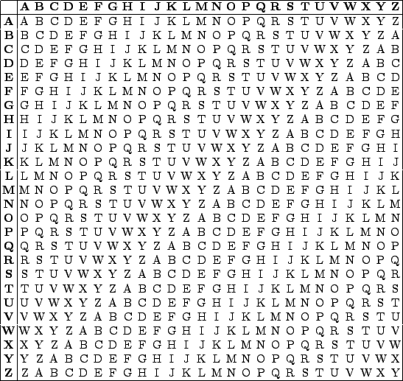
Vigenere
KEY: K E Y K E Y E
PLAIN: T R Y T H I S
D
D V W D G W
Finish encrypting (problem 6)

Slide 29
Vigenere - decrypt
KEY: K E Y
Cipherext D A M
T
T W O
Finish decrypting
(problem 7)

Slide 30
Polyalphabetic ciphers
Waioerkjmmupagrmkopokjfpoijm
rkrorkrorkrorkrkrodkoork
Same letters in ciphertext need not correspond to same letters in plaintext

Slide 31
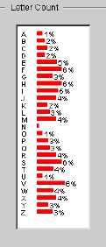
Polyalphabetic ciphers
BYIRL BFMVG SXFEJ FJLXA MSVZI QHENK FIFCY JJRIF SEXRV CICDT EITHC BQVXS GWEXF PZHHT JGSPL HUHRP FDBPX NLMFV TFMIG RBZJT XIGHT JDAMW VMSFX LHFMS UXSDG EZDIE PCZLK LISCI JIWSI HTJVE VWVFM VWISO DFKIE QRQVL EPVHM YZSRW CIMZG LWVQQ RAWRT ZFKYV HOZIF JRDHG WVWKR RQSKM XOSFM VQEGS OJEXV HGBJT XXRHT JFTMQ WASJS JPOZP ZRHUS CZZVI VHTFK XLHME MFYPG RQHCE VHHTJ TEYVS EBYMG KWYUV PXKSY YFXLH GQURV EWWAS

Slide 32
Breaking a polyalphabetic
jprwsttiqrugmyzfnvhcnscffnyjufybnqznubvqiftjujlnsxrayedzbtxcmcytmbubrwcffnyjufybnqznrugmyzfnvhcnszenyqwcpmzejar
Hint code length 3
jprwsttiqrugmyzfnvhcnscffnyjufybnqznubvqiftjujlnsxrayedzbtxcmcytmbubrwcffnyjufybnqznrugmyzfnvhcnszenyqwcpmzejar

Slide 33
Breaking a polyalphabetic
jprwsttiqrugmyzfnvhcnscffnyjufybnqznubvqiftjujlnsxrayedzbtxcmcytmbubrwcffnyjufybnqznrugmyzfnvhcnszenyqwcpmzejar
jwtrmfhsfjyquqtjsadtmtuwfjyqrmfhsnwmj
Most frequent: j
psiuynccnubzbijlxyzxcmbcnubzuynczycza
Most frequent: c
rtqgzvnfyfnnvfunrebcybrfyfnngzvneqper
Most frequent: n

Slide 34
Possible codewords
The most common English letters are
E T A O I N S H R
Finish filling out the chart
Try to make a word
Check your guess by trying to decrypt (problem 8)
 | E | T | a | o | i | n | s
J
C
N
F
Q
J
Y
J

Slide 35
Possible codewords
The most common English letters are
E T A O I N S H R
Candidate 3 letter keywords:
FUN, RUN,
 | E | T | a | o | i | n | s
J | F | Q | J | V | B | W | R
C | Y | J | C | O | U | P | K
N | J | U | N | Z | F | A | V

Slide 36
try to decrypt
jprwsttiqrugmyzfnvhcnscffnyjufybnqznubvqiftjujlnsxrayedzbtxcmcytmbubrwcffnyjufybnqznrugmyzfnvhcnszenyqwcpmzejar
http://math.ucsd.edu/~crypto/java/EARLYCIPHERS/Vigenere.html

Slide 37
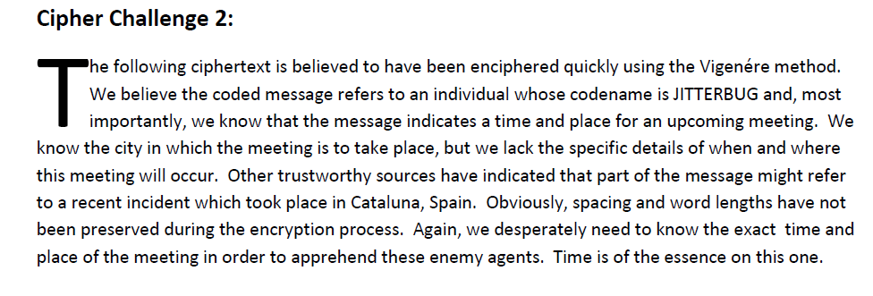
vigenere with crib
JITTE RBUG
JITTE RBUG
JITTE RBUG

Slide 38
OTHER METHODS
Try #9

Slide 39
Playfair cipher
Description from Wikipedia

Slide 40
Playfair cipher: a few facts
Any plaintext letter can be replaced by up to 5 different ciphertext letters.
Every ciphertext letter could have come from up to 5 different plaintext letters.
About 2/3 of the time one would expect to use the “rectangle” substitution scheme (note: this is symmetric – pt → CT implies that CT → pt.
with 1/6 of the time, row and 1/6 of the time, column (not symmetric).
If “ab” → “OR”, what do you know about about “ba”?

Slide 41
Playfair cipher: cryptanalysis
PB PM ON HM PD NM IR IY FH KP AV UQ OI DO
LB DZ QD GC YM IO KU KN DP PK IY BO CN RP
PC HQ XN PF BO PT KL ZN NQ TF PE PF UK TN
HT ON NU BI NQ CZ BW DY RI TF GU AF RZ
Crib: “thatalittlelight”

Slide 42
Playfair cipher: cryptanalysis
Look at the crib: “thatalittlelight”
It must have been paired like:
th at al it tl el ig ht
Which is nice since:
th at al it tl el ig ht

Slide 43
Playfair cipher: cryptanalysis
1 3
PB PM ON HM PD NM IR IY FH KP AV UQ OI DO
th at
2 4 5 6 7
LB DZ QD GC YM IO KU KN DP PK IY BO CN RP
al it tl el ig ht
PC HQ XN PF BO PT KL ZN NQ TF PE PF UK TN
HT ON NU BI NQ CZ BW DY RI TF GU AF RZ
Can you start building the key?

Slide 44
Playfair cipher: cryptanalysis
1: th → OI
to hi t t o
o h i
h
i
3: at → DO
ad to a a d
d o t
t
o
4: it → DZ
id tz i i d
d z t
t
z
5: tl → QD
tq ld t t q
q d l
l
d
Only way to combine: ddvd

Slide 45
Playfair cipher: cryptanalysis
i h
| |
d a l
t o q
|
z
l
c
Have:
Add in:
2: al → LB
alb a
l
b
c don’t like!
or
Now, add 6 & 7:
6: el → GC
eg lc e e g
g c l
l
c
7: ig → YM
iy gm i i y
y m g
g
m
Two ways to add in 6&7:
vh or dd.

Slide 46
Playfair cipher: cryptanalysis
e
h i
| |
a-l-b d
o-q t
|
z
y
Have:
c
c
Where?
e
f
g
k
m
n
u v w x
Need to add:
e g
c l
i y
m g
&

Slide 47
Playfair cipher: cryptanalysis
p h y s i
c a l b d
e f g k m
n o q r t
u v w x z

Slide 48
Online resources
Letter Frequency Analysis Calculator and Affine Cipher Calculator: http://www.wiley.com/college/mat/gilbert139343/java/java11_s.html
Shift Cipher calculator: http://www.simonsingh.net/The_Black_Chamber/caesar.html
A tool to help with monoalphabetic substitution ciphers: http://www.richkni.co.uk/php/crypta/letreplace.php http://cryptogram.org/solve_cipher.html
Applet for cryptanalysis of the Vigenere Cipher: http://math.ucsd.edu/~crypto/java/EARLYCIPHERS/Vigenere.html
Most common letters, doubles, two letter words, etc:
http://scottbryce.com/cryptograms/stats.htm

