Slide 1
How to request an Event/Task in EDGE

Slide 2
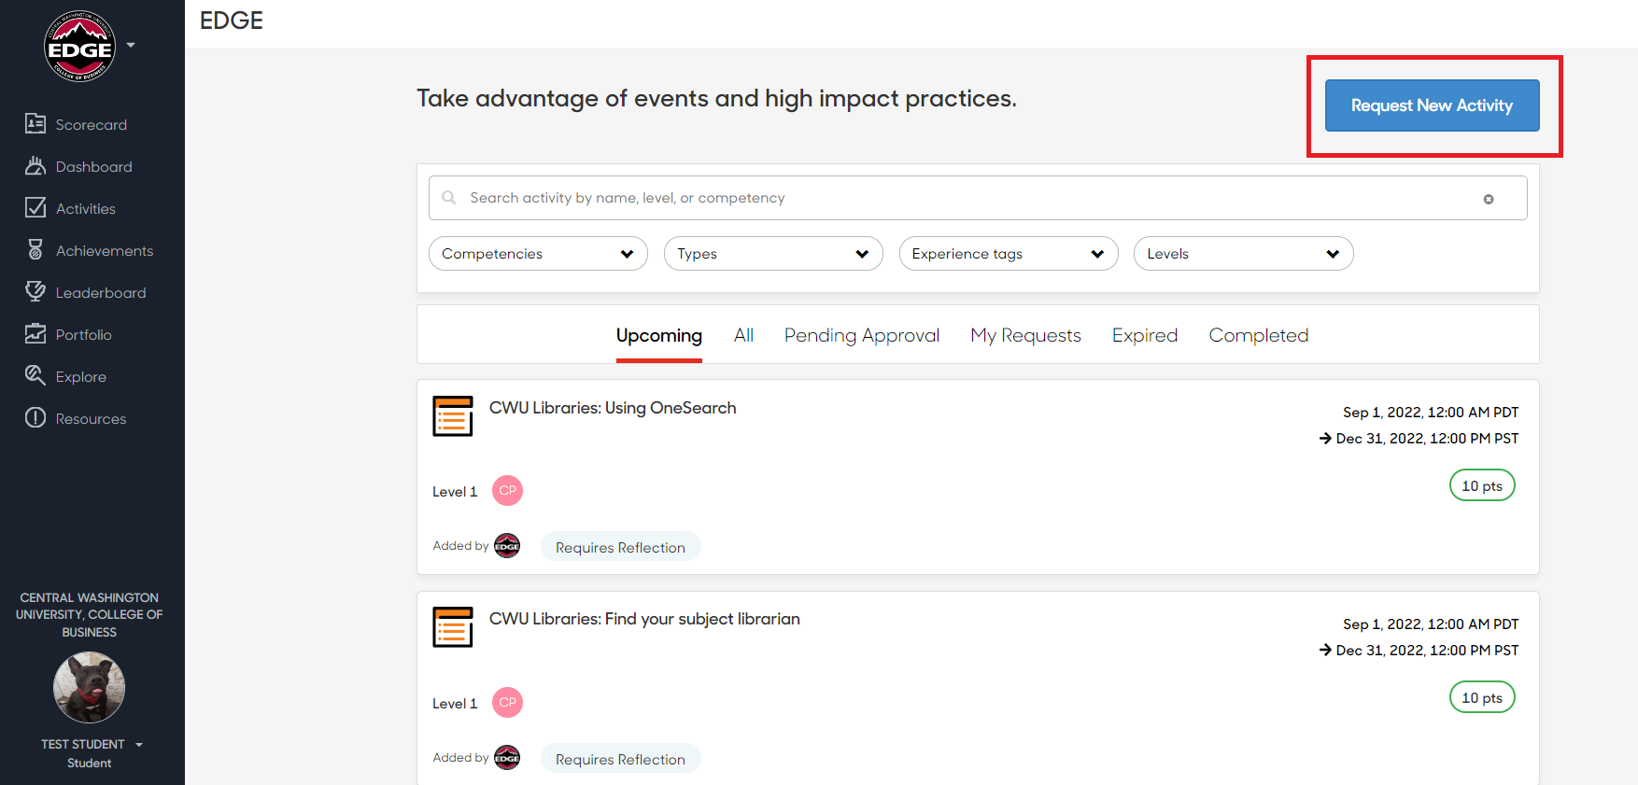
Go to the Activities tab to Request an Activity
Notes:
Choose “Request an activity”

Slide 3
Select Event or Task
Notes:
Choose “Add a new activity” > “Event”

Slide 4
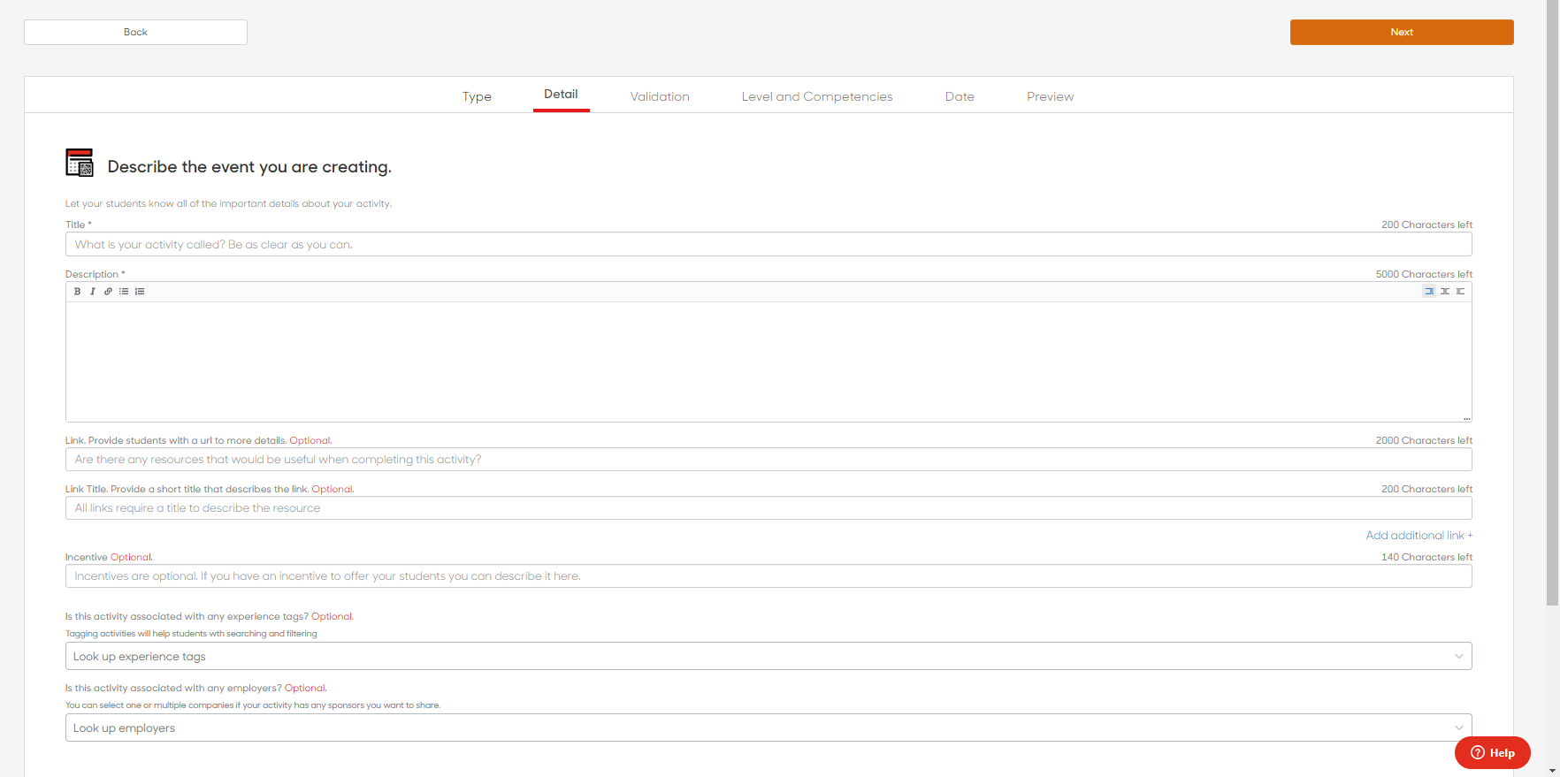
Enter the Title, Description, and any links needed for the Event or Task
(Required)
(Required)
(Optional)
(Optional)
If this is event or task is associated with your club/organization, make sure to tag it here!
Notes:
-give your activity a title (ex: ORGNAME General Body Meeting) and a brief description.
-you can add an incentive if you’d like (“free pizza”) but not required.

Slide 5
For Events
Once your event is approved by an administrator, you will automatically be emailed a QR code to use at the event to take attendance. Once the event is over, you can request to be emailed an attendance report for your records.
Notes:
-for validation, choose YES for require smart code

Slide 6
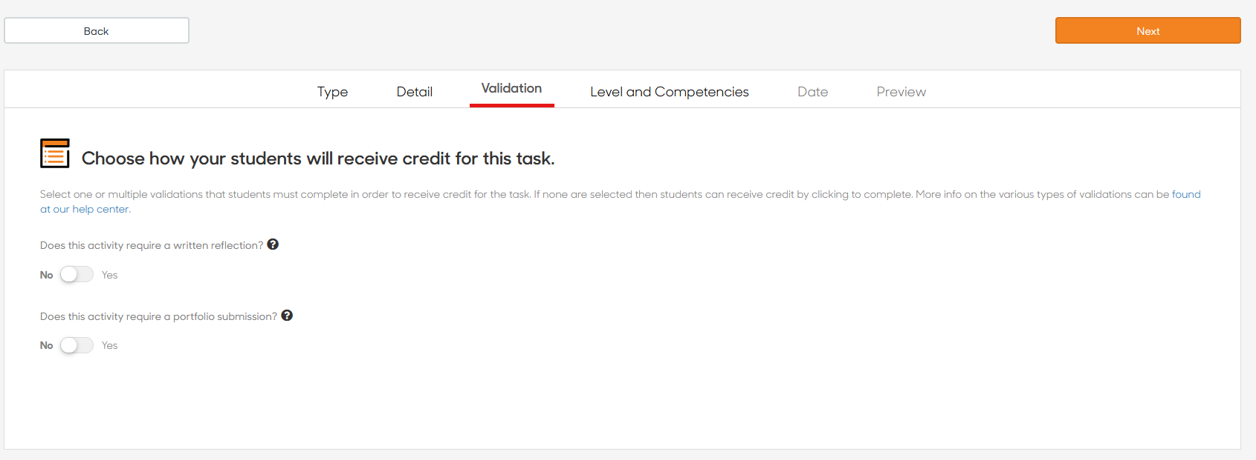
For Tasks
Written reflection presents students with a short word prompt to affirm what they learned as a result of their participation and completion of a particular experience.
Portfolio submission prompt students to upload a file/document to satisfy the completion requirement.
Notes:
-for validation, choose YES for require smart code

Slide 7
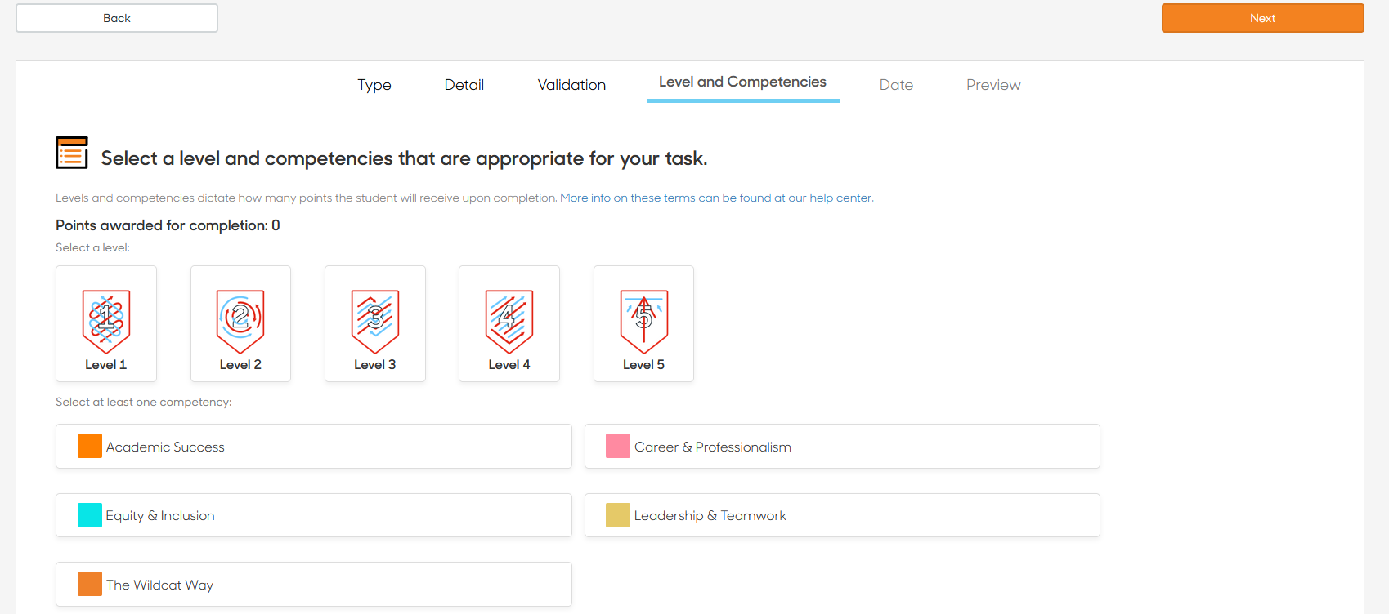
Select the level and competencies for your event
Level 1 is used for most events that provide exposure to a topic
Level 2 is used if your event includes any hands-on activity and/or networking opportunities
Select the competency that most resonates with the content of your event, or what students will learn by attending
Please select ONLY 1 competency
Notes:
Set the level and competency associated with the event

Slide 8
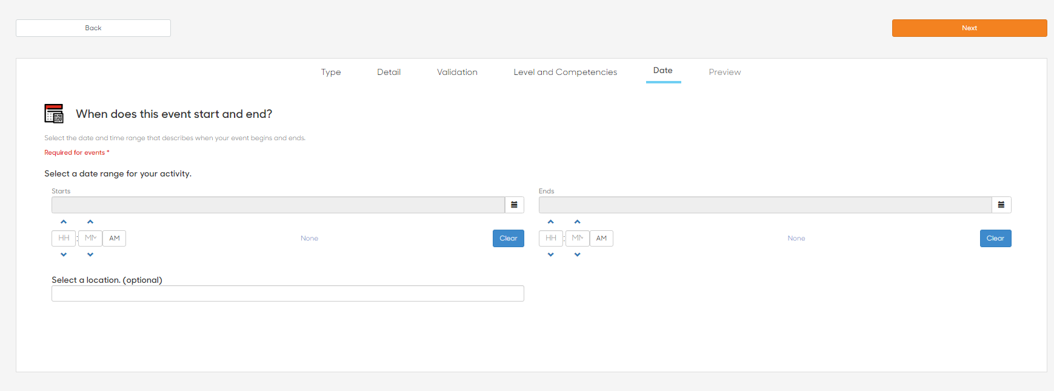
For Events: Set the date, time and location of your event
(Required)
(Required)
(Required)

Slide 9
For Tasks: Date, Time, and location are all optional
(Optional)
(Optional)
(Optional)

Slide 10
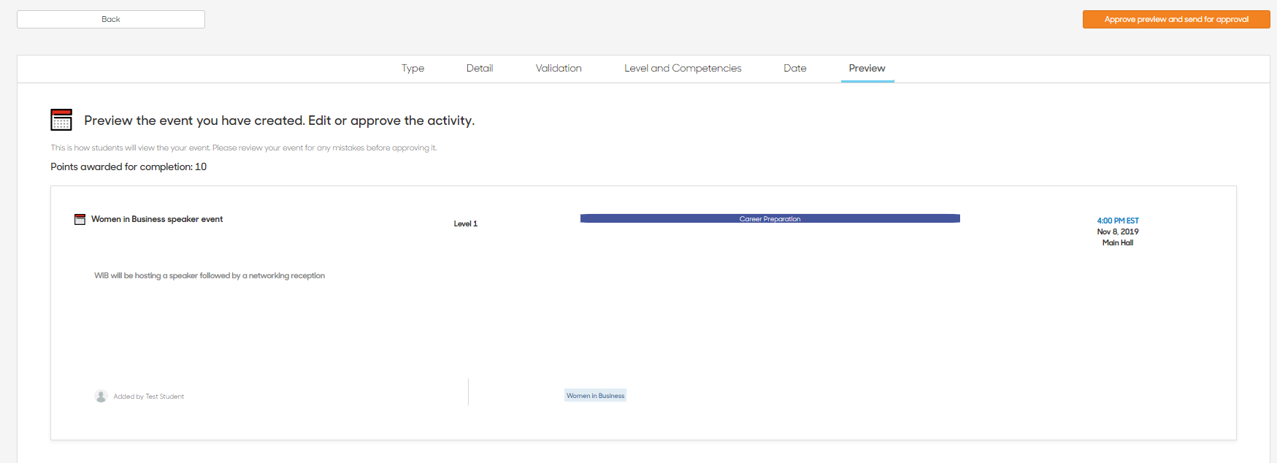
Preview and send for approval

