Slide 1
Scholarship Central!

Slide 2
Agenda
How to Apply for Scholarship Central
Scholarship review timeline
How to know if you were selected
Materials needed to apply – crafting your essay
Understanding scholarship requirements
Thank you notes and networking
Advice from a committee member
Questions

Slide 3
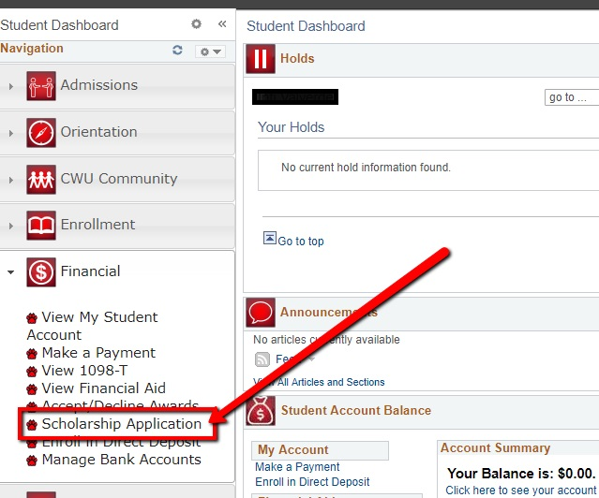
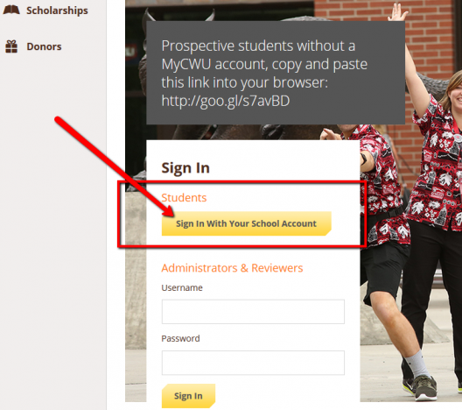
Applying via MyCWU
MyCWU > Student Dashboard > Financial > Scholarship Application

Slide 4
Technical Details
If you are prompted to log in again after MyCWU- use your First.Last@cwu.edu email and CWU password
If you are new to CWU this fall term or see a big GPA change this fall – recheck Scholarship Central after fall grades post
  You may be qualified for more scholarships
Not attending CWU yet? – You can apply for scholarships but wait a week or so after you receive your credentials.

Slide 5
Timeline
Scholarship Central is open October 2022-March 1, 2023
The bulk of the committee reviews occur during April-June
Notifications for the majority of scholarships are typically sent by end of June/early July
Some scholarships may be awarded later, including during the school year
Watch for additional scholarship application opportunities outside of Scholarship Central.

Slide 6
Notification
Scholarships are added to your financial aid package
  Even if you didn’t do a Free Application for Federal Student Aid (FAFSA)
  You can see this in MyCWU
You will get an email from the CWU Foundation

Slide 7
What You Will Need to Submit
All College of Business essays will want the same documents at a minimum
  Others may want additional documents specific to those scholarships
An Essay
A current resume
A list of three references with contact information.

Slide 8
The Essay
1,000 words maximum that addresses any or all of the following-
  Honors, awards, civic, and extra-curricular activities during college
  Educational goals
  Other goals and aspirations
  Significant work experience
  Special considerations relevant to the selection committee's decision

Slide 9
The Resume & References
The Resume
  Should be current
  Include club or volunteer work
References
  Three individuals willing to be references
  We do not need letters, please do not provide these
  Ask permission to list that individual as a reference
  Parents, family members, or roommates are not appropriate references
    Think faculty, supervisors, co-workers, volunteer organizers, advisors (if you have had significant contact)

Slide 10
Grammar Matters
We recommend editing all materials prior to submission
Consider utilizing the Writing Center (in the library) to review your essay
Consider utilizing Career Services for resume review
At a minimum have a friend/family member read over it

Slide 11
Understanding a Scholarship’s Requirements
Sometimes there are a lot of qualifications, sometimes there are not
Ed Dooley Scholarship
Recipient must have between a 2.7-3.3 Collegiate GPA
Recipient must be in good academic standing
Recipient must be a full-time student
Recipient must be a Business Administration, Accounting, or Economics major
Recipient must be viewed as a hard working and committed student
Preference will be shown toward Business Administration with a Finance specialization
Preference will be shown to students with financial need
Boeing Scholarship- Business Administration: Supply Chain Management
3.2+ Collegiate GPA
Recipient must be a Business Administration major with a specialization in Supply Chain Management
Recipient must possess excellent leadership and communication skills
Recipient must have financial need
Recipient must be from an underrepresented group
College of Business General Scholarship
3.0+ Collegiate GPA
Recipient must be a College of Business major

Slide 12
Thank You Notes and Networking
Always write the thank you note (grammar matters)
Use it as an opportunity to introduce yourself to the donor
Sometimes donors want to meet their recipient
  You don’t have to, but we encourage you to think of it as a networking opportunity
Thank you notes help inspire donors to continue donating to support more students

Slide 13
Advice from a Committee Member
Don’t count yourself out, apply
Apply to ALL scholarships you fit the criteria for
  You are using the same documents!!
Explain who you are, tell us your story
  We want to know you and what makes you tick
Don’t rehash your resume – tell us something new
    How will the money will impact your life/career

Slide 14
Questions?

